Slide 1
Chapter 8: Implementing Virtual Private Networks
CCNA Security v2.0

Slide 2
Chapter Outline
8.0 Introduction
8.1 VPNs
8.2 IPsec VPN Components and Operations
8.3 Implementing Site-to-Site IPsec VPNs with CLI
8.4 Summary

Slide 3
Section 8.1: VPNs
Upon completion of this section, you should be able to:
Describe VPNs and their benefits.
Compare site-to-site and remote-access VPNs.

Slide 4
Topic 8.1.1: VPN Overview

Slide 5
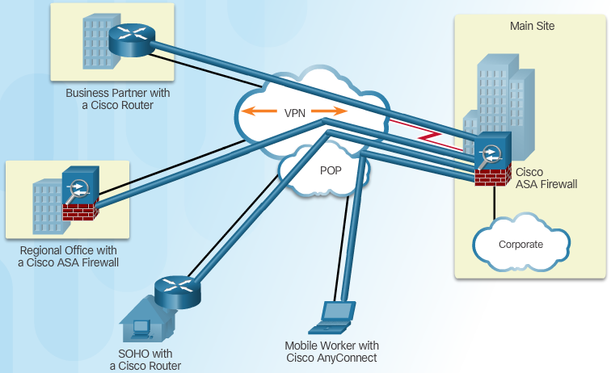
Introducing VPNs
VPN Benefits:
Cost Savings
Security
Scalability
Compatibility
Notes:
8.1.1.1 Introducing VPNs

Slide 6
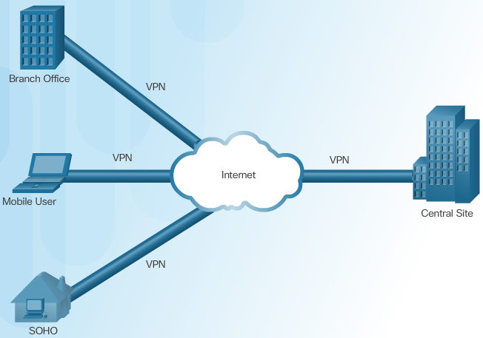
Layer 3 IPsec VPNs
Notes:
8.1.1.2 Layer 3 IPsec VPNs

Slide 7
Topic 8.1.2: VPN Technologies

Slide 8
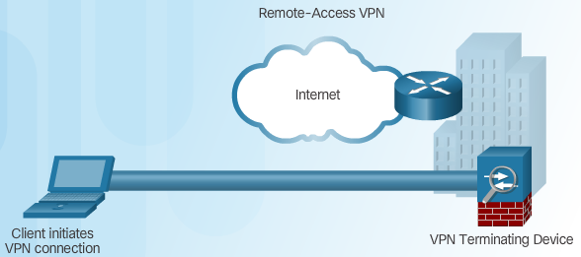
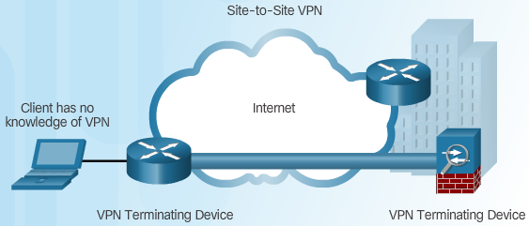
Two Types of VPNs
Remote-Access VPN
Site-to-Site VPN Access
Notes:
8.1.2.1 Two Types of VPNs

Slide 9
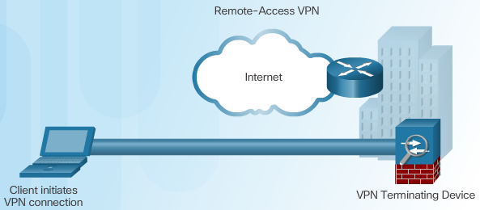
Components of Remote-Access VPNs
Notes:
8.1.2.2 Components of Remote-Access VPNs

Slide 10

Components of Site-to-Site VPNs
Notes:
8.1.2.3 Components of Site-to-Site VPNs
8.1.2.4 Activity – Compare Remote-Access and Site-to-Site VPNs

Slide 11
Section 8.2: IPsec VPN Components and Operation
Upon completion of this section, you should be able to:
Describe the IPsec protocol and its basic functions.
Compare AH and ESP protocols.
Describe the IKE protocol.

Slide 12
Topic 8.2.1: Introducing IPsec

Slide 13
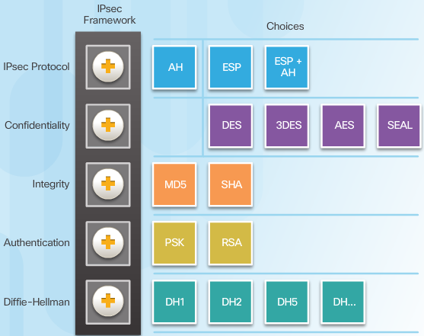
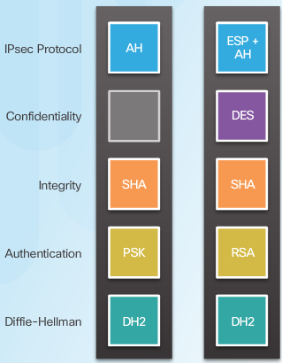
IPsec Technologies
IPsec Implementation Examples
IPsec Framework
Notes:
8.2.1.1 IPsec Technologies

Slide 14
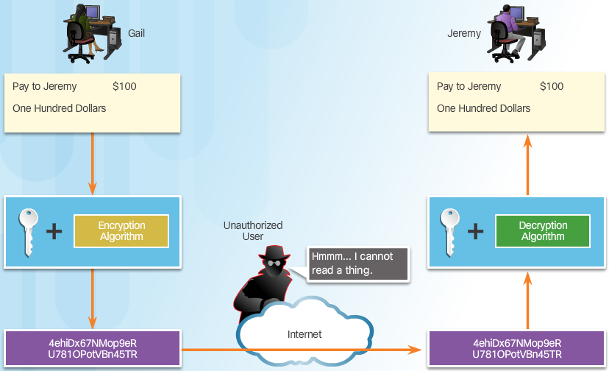
Confidentiality
Confidentiality with Encryption:
Notes:
8.2.1.2 Confidentiality

Slide 15
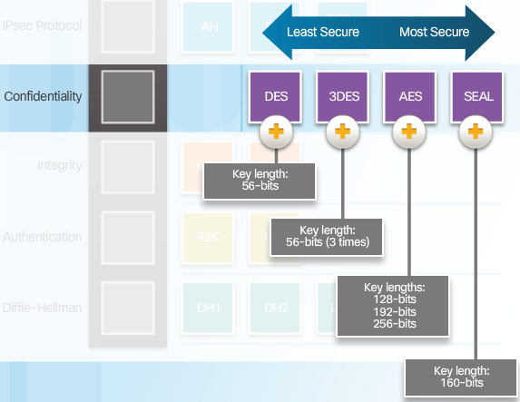
Confidentiality (Cont.)
Encryption Algorithms:
Notes:
8.2.1.2 Confidentiality (Cont.)

Slide 16
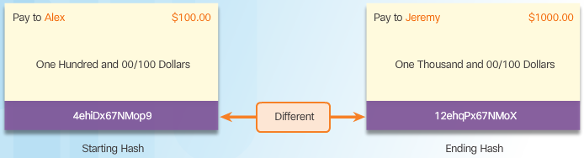
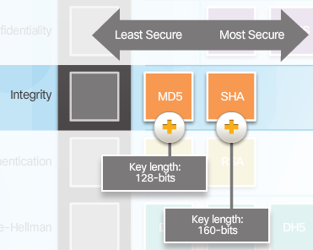
Integrity
Hash Algorithms
Security of Hash Algorithms
Notes:
8.2.1.3 Integrity

Slide 17
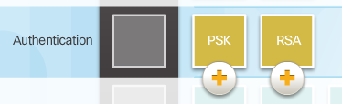
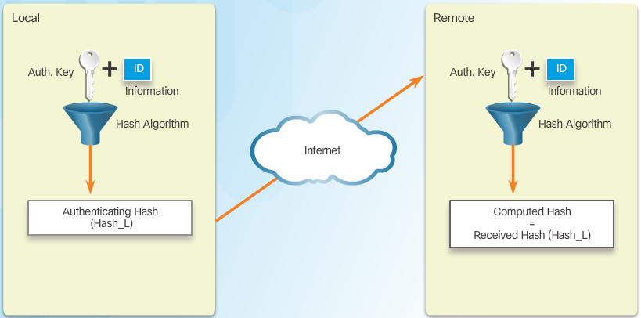
Authentication
Peer Authentication Methods
PSK
Notes:
8.2.1.4 Authentication

Slide 18
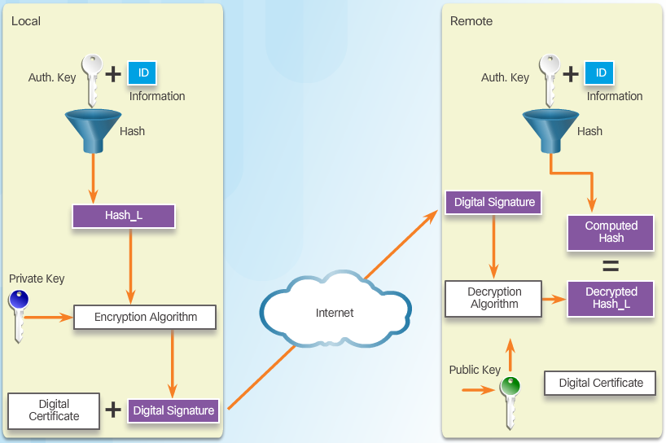
Authentication (Cont.)
RSA
Notes:
8.2.1.4 Authentication (Cont.)

Slide 19
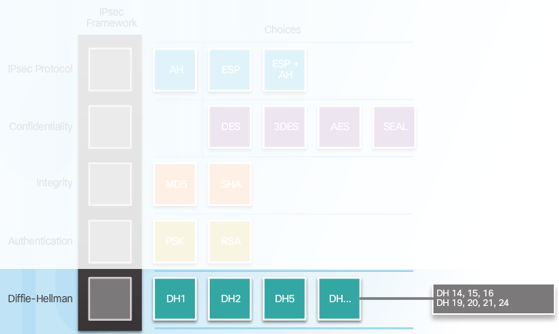
Secure Key Exchange
Diffie-Hellman Key Exchange
Notes:
8.2.1.5 Secure Key Exchange
8.2.1.6 Activity – Identify the Components fo the IPsec Framework

Slide 20
Topic 8.2.2: IPsec Protocols

Slide 21
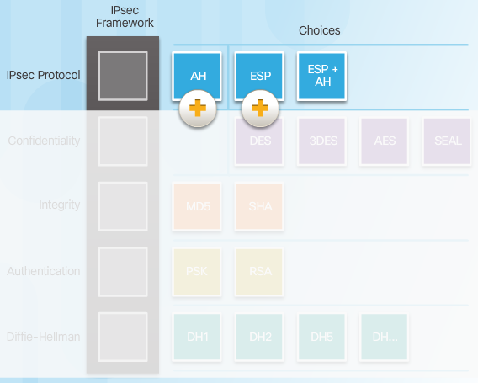
IPsec Protocol Overview
Notes:
8.2.2.1 IPsec Protocol Overview

Slide 22
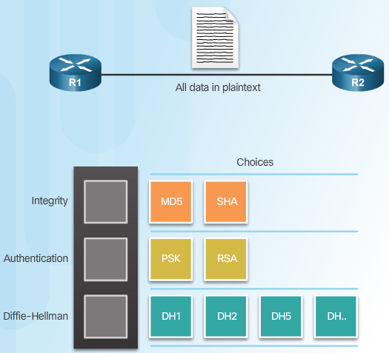
Authentication Header
AH Protocols
Notes:
8.2.2.2 Authentication Header

Slide 23
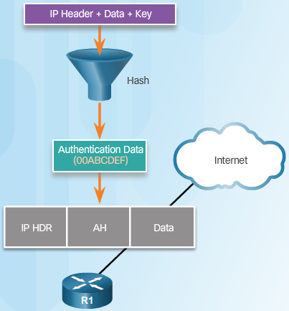
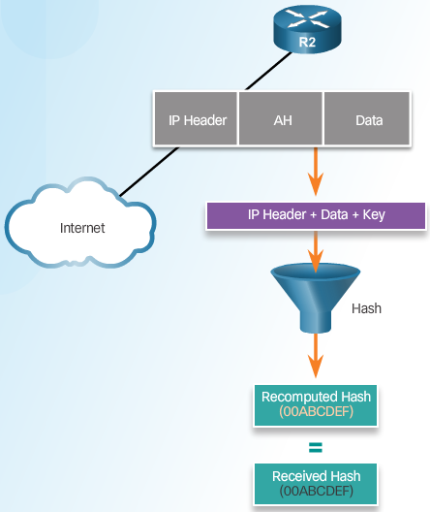
Authentication Header (Cont.)
Router Creates Hash and Transmits to Peer
Peer Router Compares Recomputed Hash to Received Hash
Notes:
8.2.2.2 Authentication Header (Cont.)

Slide 24
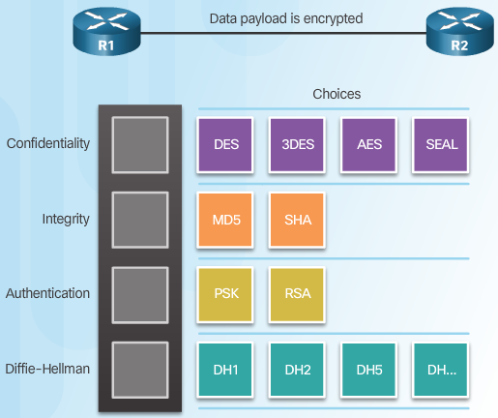
ESP
Notes:
8.2.2.3 ESP

Slide 25
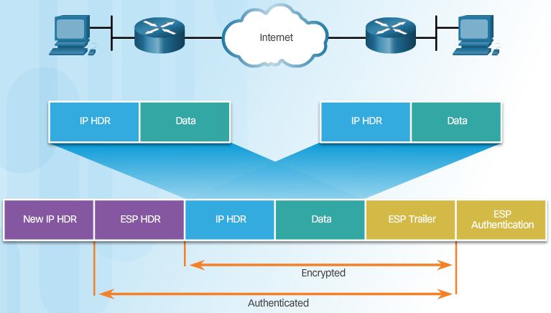
ESP Encrypts and Authenticates
Notes:
8.2.2.4 ESP Encrypts and Authenticates

Slide 26
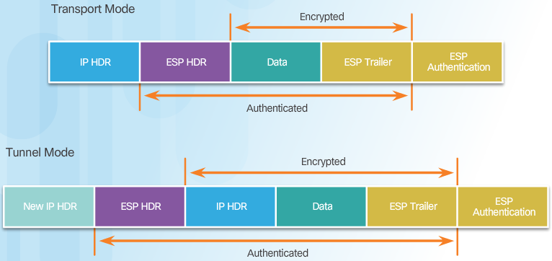
Transport and Tunnel Modes
Apply ESP and AH in Two Modes
Notes:
8.2.2.5 Transport and Tunnel Modes

Slide 27
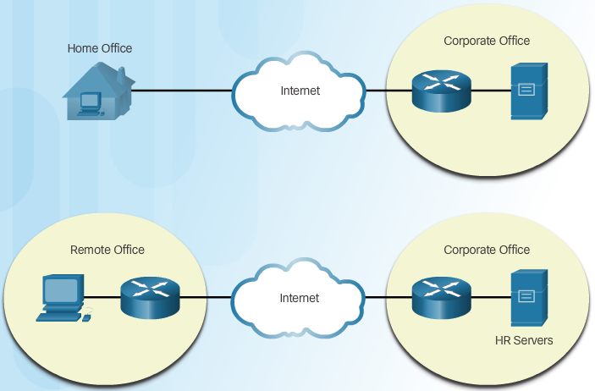
Transport and Tunnel Modes (Cont.)
ESP Tunnel Mode
Notes:
8.2.2.5 Transport and Tunnel Modes (Cont.)
8.2.2.6 Activity – Compare AH and ESP

Slide 28
Topic 8.2.3: Internet Key Exchange

Slide 29
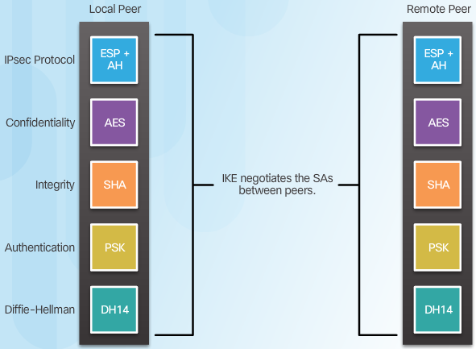
The IKE Protocol
Notes:
8.2.3.1 The IKE Protocol

Slide 30
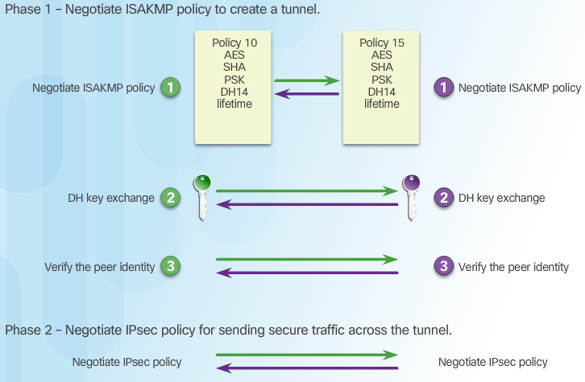
Phase 1 and 2 Key Negotiation
Notes:
8.2.3.2 Phase 1 and 2 Key Negotiation

Slide 31
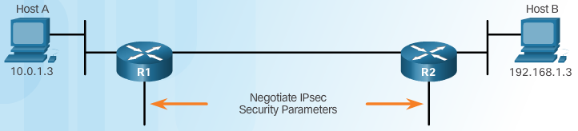
Phase 2: Negotiating SAs
Notes:
8.2.3.3 Phase 2: Negotiating Sas
8.2.3.4 Video Tutorial – IKE Phase 1 and Phase 2

Slide 32
Section 8.3: Implementing Site-to-Site IPsec VPNs with CLI
Upon completion of this section, you should be able to:
Describe IPsec negotiation and the five steps of IPsec configuration.
Configure the ISAKMP policy.
Configure the IPsec policy.
Configure and apply a crypto map.
Verify the IPsec VPN.

Slide 33
Topic 8.3.1: Configuring a Site-to-Site IPsec VPN

Slide 34
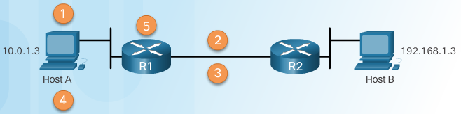
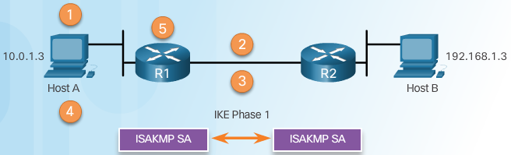
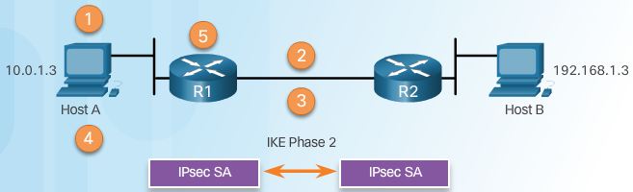
IPsec Negotiation
IPsec VPN Negotiation: Step 1 - Host A sends interesting traffic to Host B.
IPsec VPN Negotiation: Step 2 - R1 and R2 negotiate an IKE Phase 1 session.
IPsec VPN Negotiation: Step 3 - R1 and R2 negotiate an IKE Phase 2 session.
Notes:
8.3.1.1 IPsec Negotiation

Slide 35
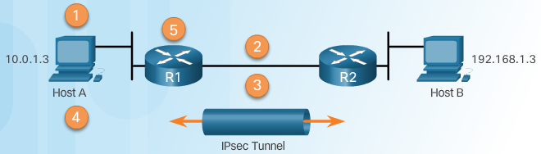
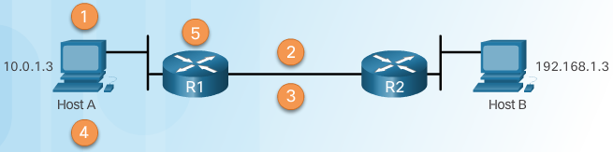
IPsec Negotiation (Cont.)
IPsec VPN Negotiation: Step 4 - Information is exchanged via IPsec tunnel.
IPsec VPN Negotiation: Step 5 - The IPsec tunnel is terminated.
Notes:
8.3.1.1 IPsec Negotiation (Cont.)

Slide 36
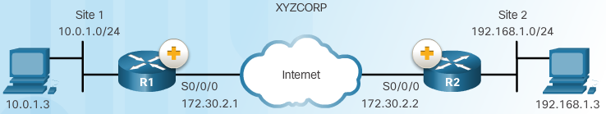
Site-to-Site IPsec VPN Topology
Notes:
8.3.1.2 Site-to-Site IPsec VPN Topology

Slide 37
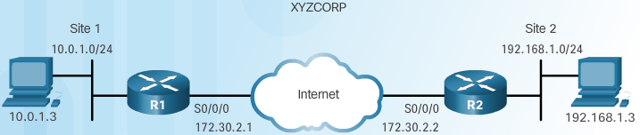
IPsec VPN Configuration Tasks
XYZCORP Security Policy | Configuration Tasks
Encrypt traffic with AES 256 and SHA | 1. Configure the ISAKMP policy for IKE Phase 1
Authentication with PSK | 2. Configure the IPsec policy for IKE Phase 2
Exchange keys with group 24 | 3. Configure the crypto map for IPsec policy
ISAKMP tunnel lifetime is 1 hour | 4. Apply the IPsec policy
IPsec tunnel uses ESP with a 15-min. lifetime | 5. Verify the IPsec tunnel is operational
Notes:
8.3.1.3 IPsec VPN Configuration Tasks

Slide 38
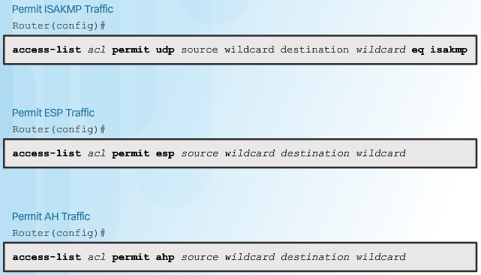
Existing ACL Configurations
ACL Syntax for IPsec Traffic
Notes:
8.3.1.4 Existing ACL Configurations

Slide 39
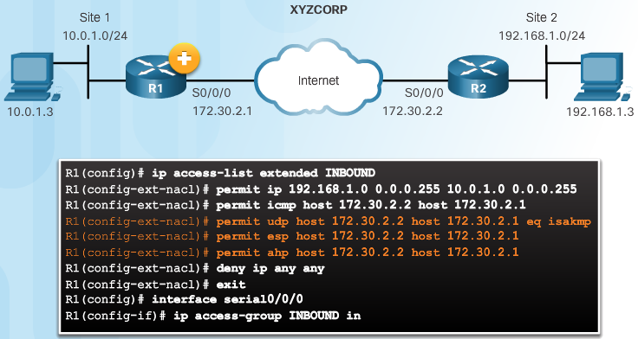
Existing ACL Configurations (Cont.)
Permitting Traffic for IPsec Negotiations
Notes:
8.3.1.4 Existing ACL Configurations (Cont.)

Slide 40
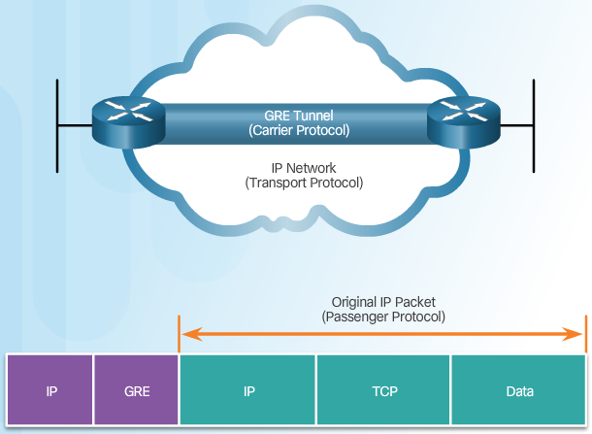
Introduction to GRE Tunnels
Notes:
8.3.1.5 Introduction to GRE Tunnels
8.3.1.6 Activity – Order the IPsec Negotiation Steps

Slide 41
Topic 8.3.2: ISAKMP Policy

Slide 42
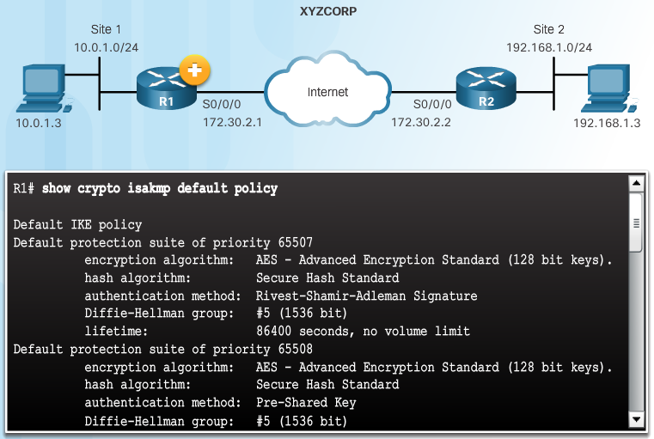
The Default ISAKMP Policies
Notes:
8.3.2.1 The Default ISAKMP Policies

Slide 43
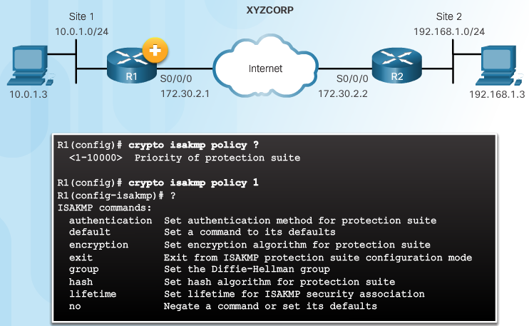
Syntax to Configure a New ISAKMP Policy
Notes:
8.3.2.2 Syntax to Configure a New ISAKMP Policy

Slide 44
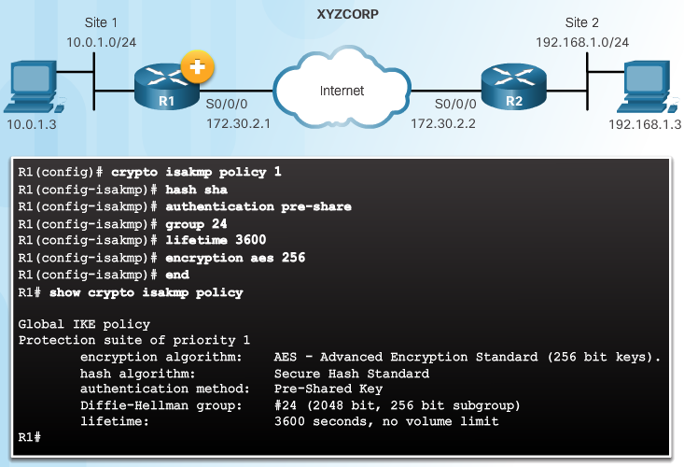
XYZCORP ISAKMP Policy Configuration
Notes:
8.3.2.3 XYZCORP ISAKMP Policy Configuration

Slide 45
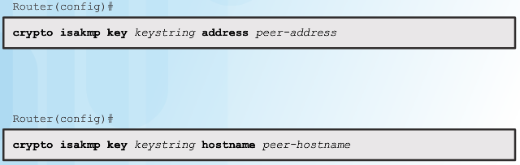
Configuring a Pre-Shared Key
The crypto isakmp key Command
Notes:
8.3.2.4 Configuring a Pre-Shared Key

Slide 46
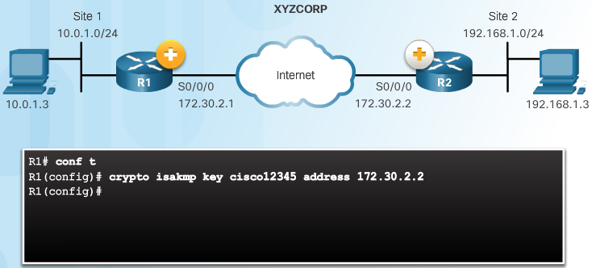
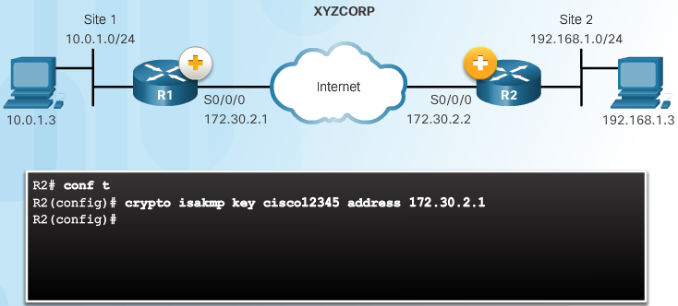
Configuring a Pre-Shared Key (Cont.)
Pre-Shared Key Configuration
Notes:
8.3.2.4 Configuring a Pre-shared Key (Cont.)

Slide 47
Topic 8.3.3: IPsec Policy

Slide 48
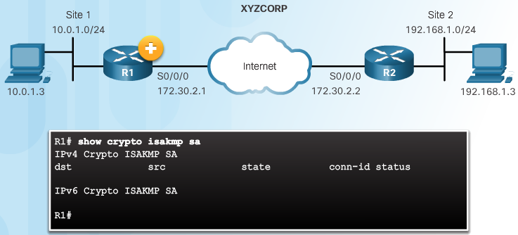
Define Interesting Traffic
The IKE Phase 1 Tunnel Does Not Exist Yet
Notes:
8.3.3.1 Define Interesting Traffic

Slide 49
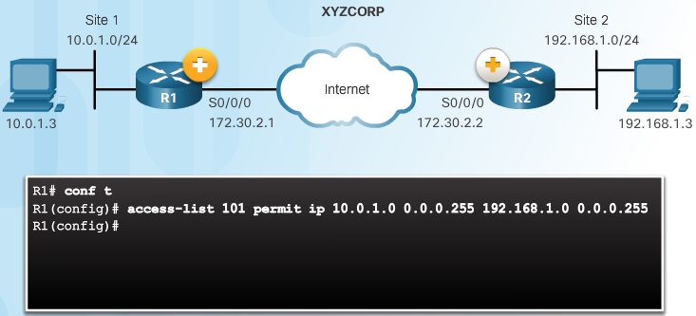
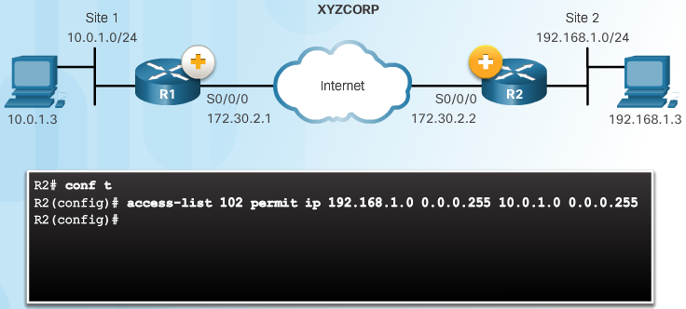
Define Interesting Traffic (Cont.)
Configure an ACL to Define Interesting Traffic
Notes:
8.3.3.1 Define Interesting Traffic (Cont.)

Slide 50
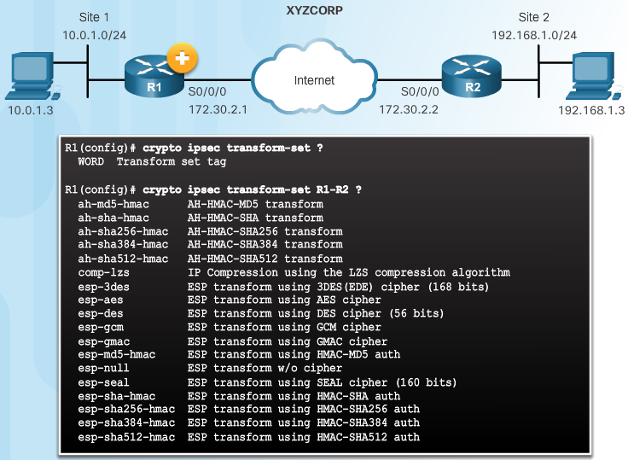
Configure IPsec Transform Set
The crypto ipsec transform-set Command
Notes:
8.3.3.2 Configure IPsec Transform Set

Slide 51
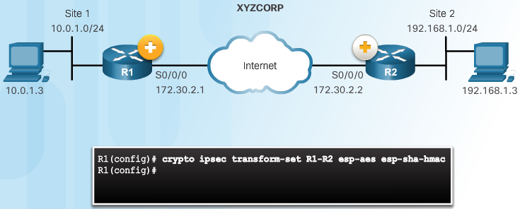
Configure IPsec Transform Set (Cont.)
The crypto ipsec transform-set Command
Notes:
8.3.3.2 Configure IPsec Transform Set (Cont.)

Slide 52
Topic 8.3.4: Crypto Map

Slide 53
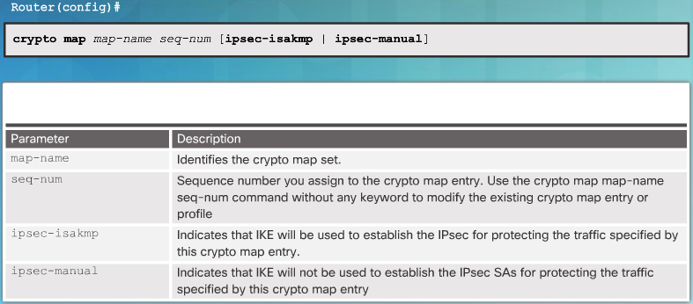
Syntax to Configure a Crypto Map
Notes:
8.3.4.1 Syntax to Configure a Crypto Map

Slide 54
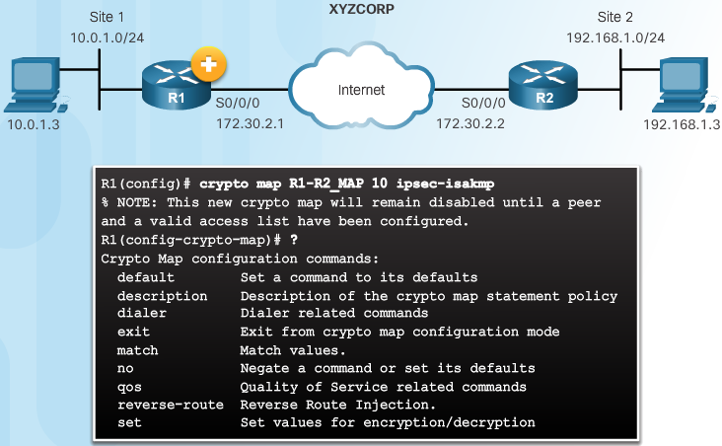
Syntax to Configure a Crypto Map (Cont.)
Crypto Map Configuration Commands
Notes:
8.3.4.1 Syntax to Configure a Crypto Map (Cont.)

Slide 55
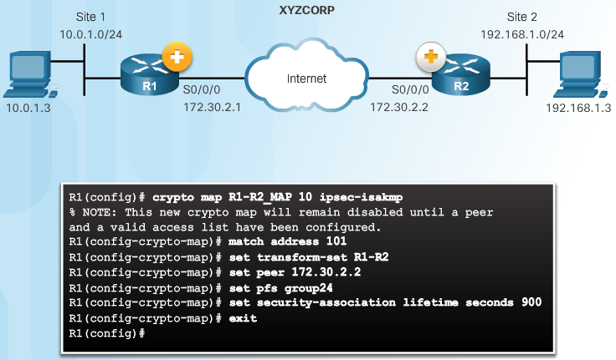

XYZCORP Crypto Map Configuration
Crypto Map Configuration:
Notes:
8.3.4.2 XYZCORP Crypto Map Configuration

Slide 56

XYZCORP Crypto Map Configuration (Cont.)
Crypto Map Configuration:
Notes:
8.3.4.2 XYZCORP Crypto Map Configuration (Cont.)

Slide 57

Apply the Crypto Map
Notes:
8.3.4.3 Apply the Crypto Map

Slide 58
Topic 8.3.5: IPsec VPN

Slide 59

Send Interesting Traffic
Use Extended Ping to Send Interesting Traffic
Notes:
8.3.5.1 Send Interesting Traffic
8.3.5.2 Verify ISAKMP and IPsec Tunnels

Slide 60

Verify ISAKMP and IPsec Tunnels
Verify the ISAKMP Tunnel is Established
Notes:
8.3.5.2 Verify ISAKMP and IPsec Tunnels

Slide 61

Verify ISAKMP and IPsec Tunnels (Cont.)
Verify the IPsec Tunnel is Established
Notes:
8.3.5.2 Verify ISAKMP and IPsec Tunnels (Cont.)

Slide 62
Section 8.4: Summary
Chapter Objectives:
Explain the purpose of VPNs.
Explain how IPsec VPNs operate.
Configure a site-to-site IPsec VPN, with pre-shared key authentication, using the CLI.
Notes:
8.4.1.1 Video Demonstration – Site-to-Site IPsec VPN Configuration
8.4.1.2 Packet Tracer – Configure and Verify a Site-to-Site IPsec VPN
8.4.1.3 Lab – Configuring a Site-to-Site VPN
8.4.1.4 Chapter 8: Implementing Virtual Private Networks

Slide 64


Instructor Resources
Remember, there are helpful tutorials and user guides available via your NetSpace home page. (https://www.netacad.com)
These resources cover a variety of topics including navigation, assessments, and assignments.
A screenshot has been provided here highlighting the tutorials related to activating exams, managing assessments, and creating quizzes.
1
2
Notes:
https://www.netacad.com

